Slide 1
Unity Shaders
Making shaders with the use of Shader Graph
Presented to you by:
Roel Borkent, Jelle Dimmendaal, Mike Lamsma, Sven Timmers, Rick Zweers

Slide 2
Content
What are shaders?
Shader code example
Shader Graph
Render Pipelines
Shader Graph examples
Exercise
Further reading
Sources
Notes:
Rick: begin t/m Render Pipelines
Jelle: Shader Graph t/m sources

Slide 3
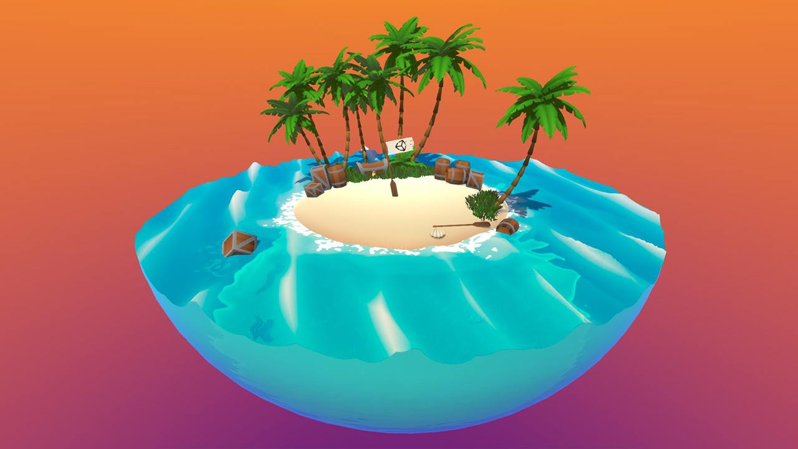
What are shaders?
Definition: “A shader is a program that runs in the graphics pipeline and tells the computer how to render each pixel. These programs are called shaders because they are often used to control lighting and shading effects.”

Slide 4
Shader code example
Notes:
Zie file in folder.

Slide 5
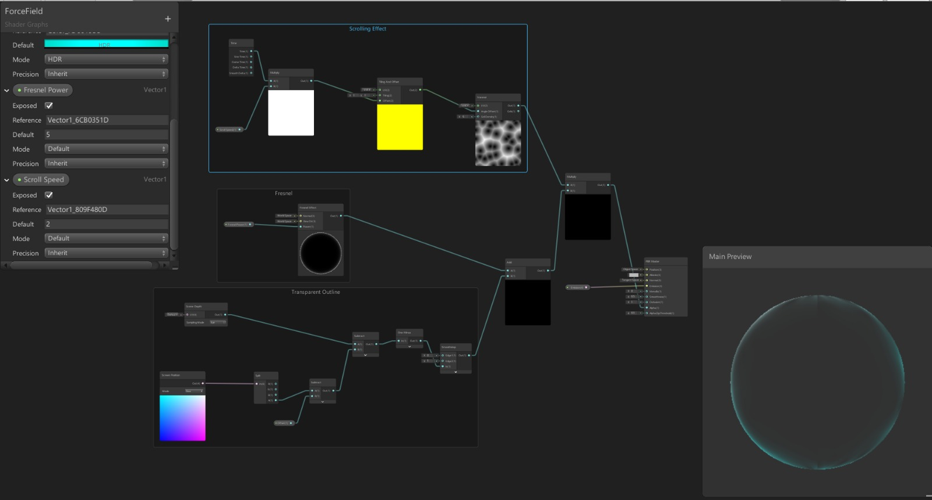
Shader Graph
Same possibilities
Visual scripting
Live preview
Friendlier for designers/artists
Notes:
Since 2018.x and higher

Slide 6
Render Pipelines
Scriptable Render Pipeline
Lightweight Render Pipeline (LWRP)
Will be renamed to: Universal Render Pipeline (2019.3 and up)
High Definition Render Pipeline (HDRP)
Production ready in 2019.3

Slide 7
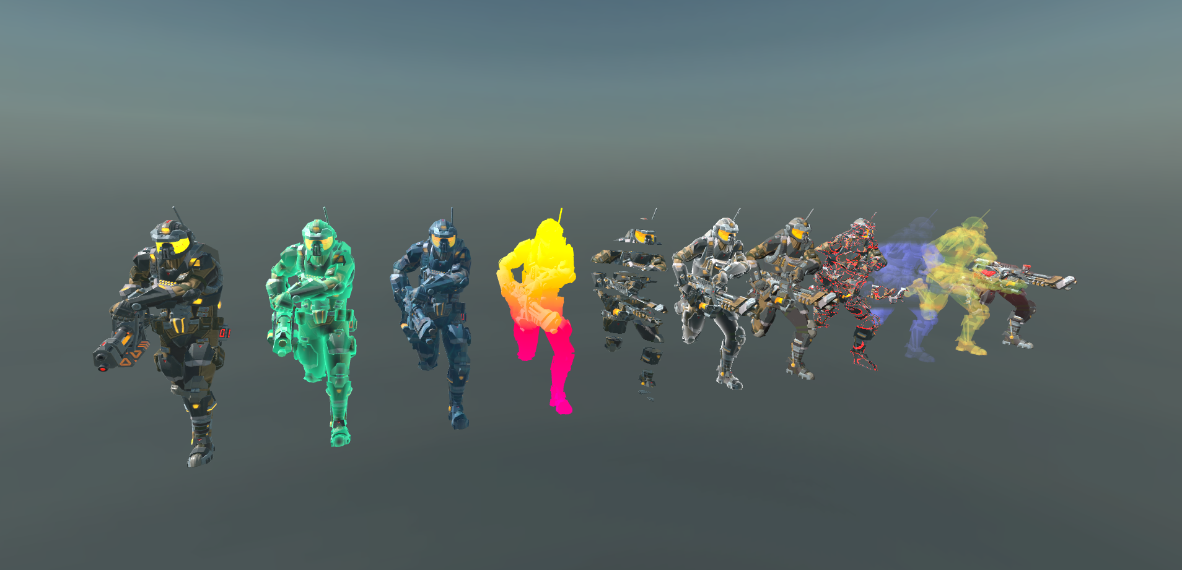
Shader Graph examples

Slide 8
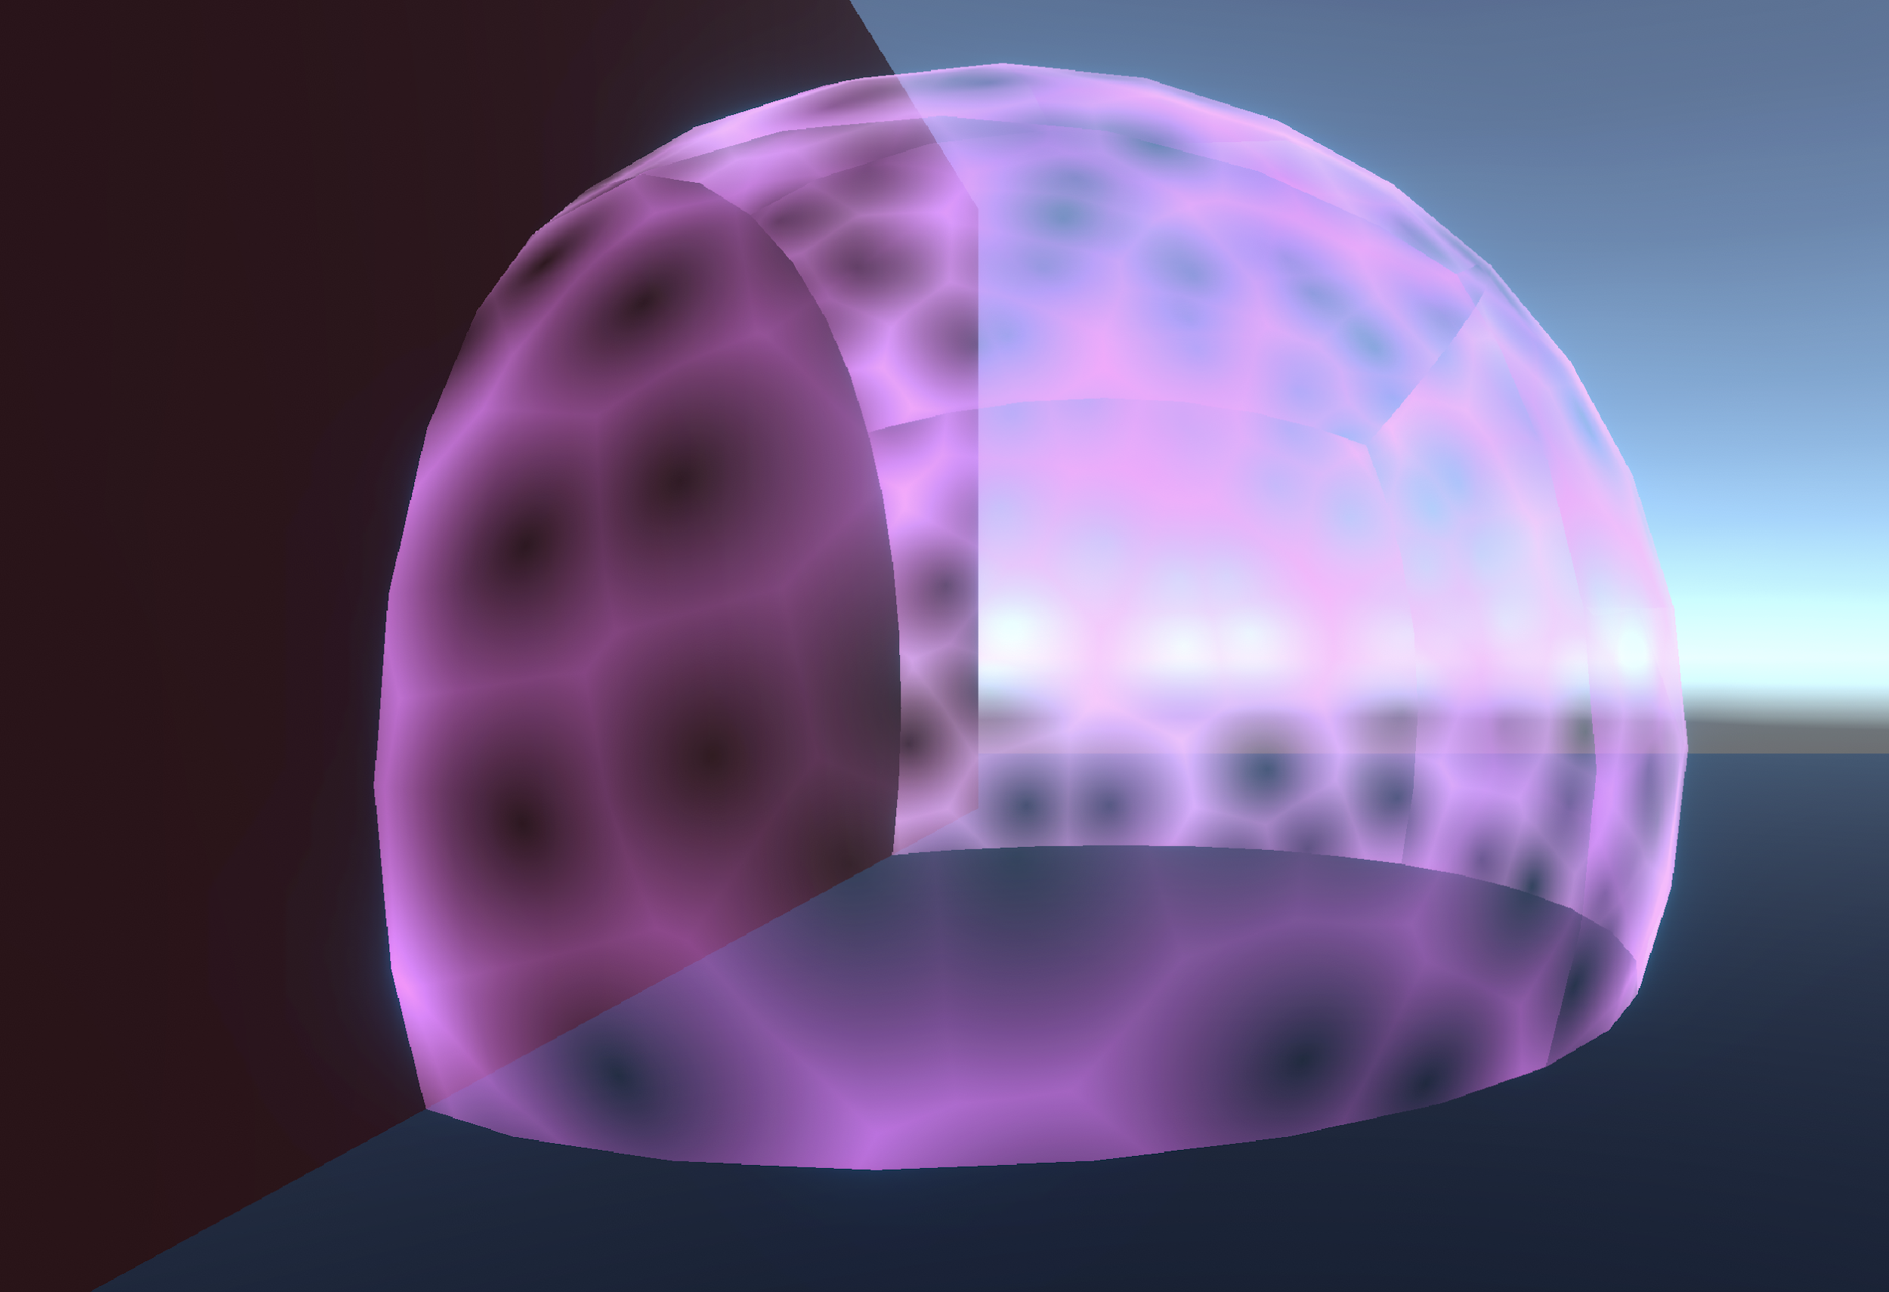
Exercise

Slide 9
Further reading
Unity Shader examples: https://github.com/UnityTechnologies/ShaderGraph_ExampleLibrary
Unity blog: https://blogs.unity3d.com/2018/10/05/art-that-moves-creating-animated-materials-with-shader-graph/

Slide 10
Sources
Unity. (2018, 5 oktober). Art That Moves: Creating Animated Materials with Shader Graph – Unity Blog. Geraadpleegd op 29 oktober 2019, van https://blogs.unity3d.com/2018/10/05/art-that-moves-creating-animated-materials-with-shader-graph/
Shehata, O. (2015, 15 april). A Beginner’s Guide to Coding Graphics Shaders. Geraadpleegd op 29 oktober 2019, van https://gamedevelopment.tutsplus.com/tutorials/a-beginners-guide-to-coding-graphics-shaders--cms-23313

